Slide 1
Probabilistic Programming
Monday

Slide 2
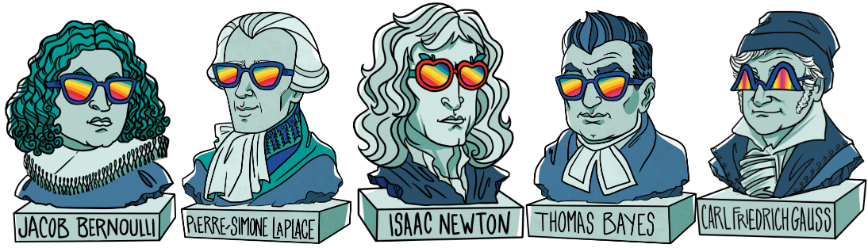
conda install -c conda-forge pymc3
conda install -c conda-forge theano

Slide 3
ML vs Stats

Slide 4
ML vs Stats
Medium to big data
Unrealistic assumptions on data
Optimize loss function
Gives point estimates
Black box model
Predictions, classification, clustering, dimension reduction
Small, medium data,
Unrealistic assumptions on data
hypothesis testing, NULL, p-values,
white box model => understanding,
valid at Infinite (law large numbers)
Explanations, understanding

Slide 5
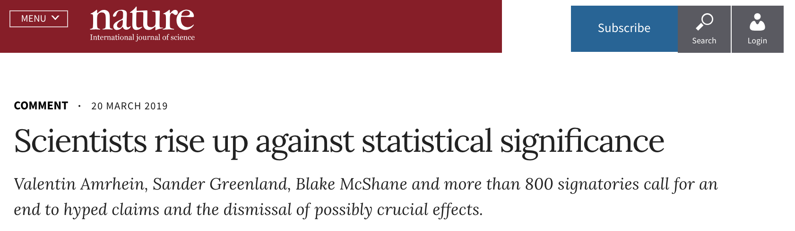
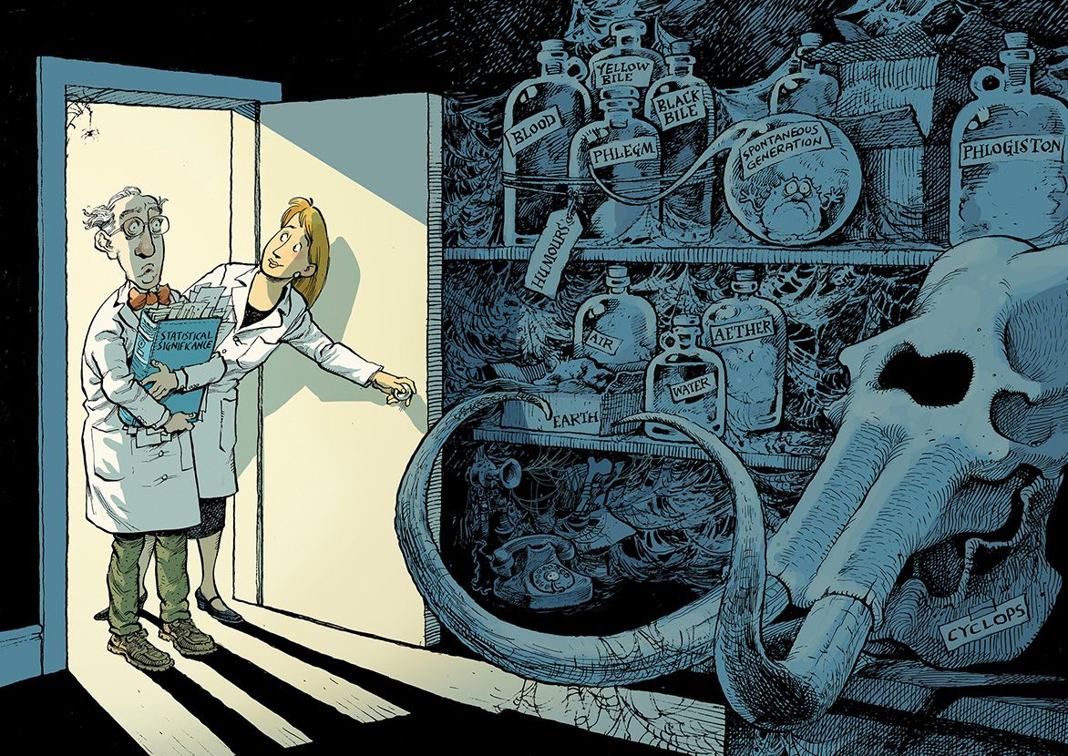
https://www.nature.com/articles/d41586-019-00857-9?sf209721125=1

Slide 6
Probabilistic programming

Slide 7
Probabilistic programming
Small, medium data,
White box understanding
No irrealistic assumptions
Actual data modelisation choice
Use actual knowledge
Specific loss functions

Slide 8
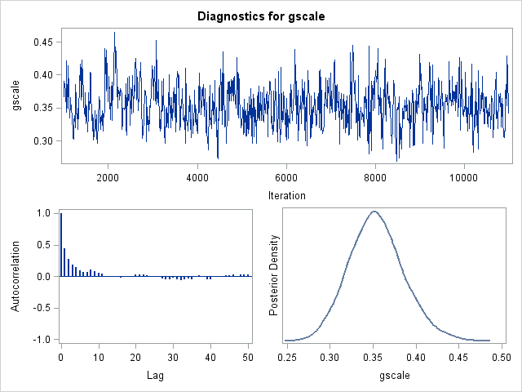
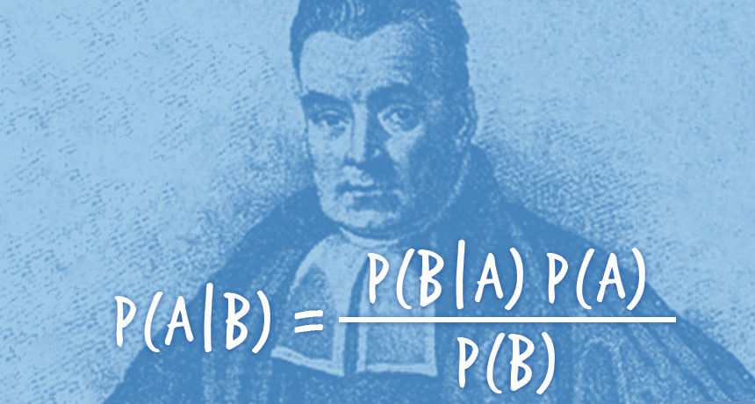
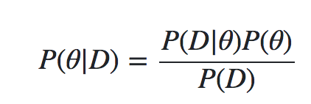
Probabilistic programming: Bayes + Sampling
Conjugate prior: analytical form of posterior for some prior distributions
Gaussian ⬄ Guassian
Beta ⬄ Binomial
Bayes 1763 – Laplace 1812
When no conjugate prior
MCMC – Metropolis Hasting 1953
Gradient based sampling
Theano
Tensorflow Probabilities
Pyro …
Variational Inference (ADVI)

Slide 9





Probabilistic programming
Stan
PyMC3
Pyro
Tensorflow Probability
Edward
Greta
Infer.NET
BUGS
JAGS
Modelisation
Program with variables as distributions
Bayes
Sampling

Slide 10
Use case: Retail credit

Slide 11
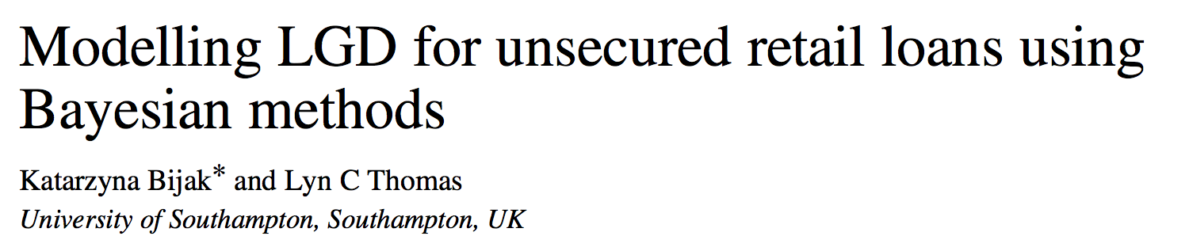
LGD
Loss Given Default (LGD) is the loss borne by the bank when a customer defaults on a loan.
Frequentist
2 separate regression models are estimated independently
M1: default yes / no
binary classification, logistic regression, probability of default
M2: by how much: linear regression
Model = M1 * M2
Point estimates
Bayesian:
single, hierarchical model
The result is an individual predictive distribution of LGD for each loan, rather than just a single number.

Slide 12
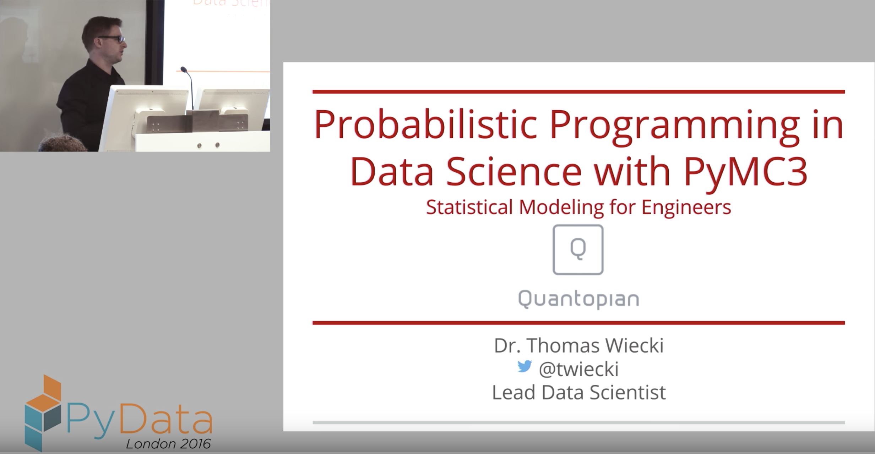
Use case: Quantopian
https://www.youtube.com/watch?v=LlzVlqVzeD8

Slide 13
Probabilistic programming is a new programming paradigm that provides the best of both worlds and revolutionizes the field of machine learning.
Recent methodological advances in sampling algorithms like Markov Chain Monte Carlo (MCMC), as well as huge increases in processing power, allow for almost complete automation of the inference process.
Data scientists can create complex generative Bayesian models tailored to the structure of the data and specific problem at hand, but without the burden of mathematical tractability or limitations due to mathematical simplifications.

Slide 14
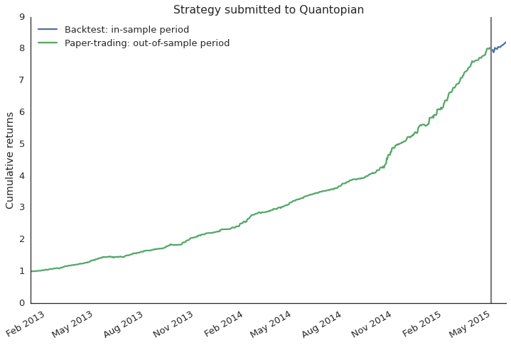
How to select strategies for fund?
paper trading
backtest
Notes:
Most historical backtest performances look amazing, they almost never lose money
Then however, when you set it live and deploy it with capital a common failure mode is that it does not seem to perform as the backtest suggested
Problem is, it is very easy to overfit the backtest so that it only works on historical data but not going forward

Slide 15
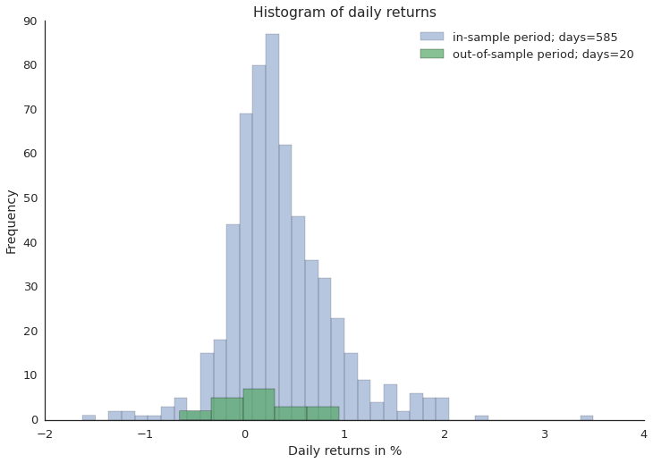
Does out-of-sample data support backtest?
Notes:
Another way to look at that same data is just as a histogram of daily returns
Here the question becomes, do the out-of-sample returns come from the same distribution as the in-sample returns
Difficult problem because out-of-sample data is always scarce and returns are generally noisy
Now how would you solve that problem? There are several approaches that a data scientist might follow.

Slide 16
Blackbox Machine Learning
Classifier
Data
Predictions
Train classifier to distinguish between distributions.
Classification framework not well suited.
Blackbox: Not good at conveying what was learned.
Notes:
It is fair to say that machine learning has revolutionized data science and is definitely the go-to choice in a lot of cases. But how might we apply it in this specific case?
One possibility would be to try and train a classifier and if it is able to differentiate between these two distributions in cross-validation we would assume that the backtest is overfit.
Now you will probably say that machine learning is just not the right tool for the job in this case and that is precisely the point I am trying to convey.
Most machine learning algorithms are very static in what they do so to apply them we would have to change our problem and shoe-horn it into this framework: “If your only tool is a hammer, everything starts to look like a nail”. This is actually very common.
Another problem with this approach is that we don’t really have a measure of confidence in our answer.
Lastly, these blackbox algorithms are often bad at conveying what they have learned from the data. And that might be fine if you only care about prediction but if you actually want to learn something from your data this tool is less well suited.

Slide 17
Frequentist Statistics
Hypothesis
Test
Data
p-value
Gray box - implicit assumptions:
normality (violated here, daily returns have heavy tails)
Hard to change assumptions.
p-value is not the probability we care about.
Notes:
Alternatively, we could use frequentist statistics which is much better suited for this type of problem
Usually, you run a hypothesis test like the t-test which produces a p-value
While tempting, this p-value is actually not the probability that the two distributions are different. Unfortunately I don’t have enough time to go into this subtlety but it has far reaching implications.
In addition, there are various implicit assumptions, for example, the t-test assumes your data to be normally distributed which unfortunately is not the case for daily returns as they are known to have much heavier tails or extreme events which you often observed in the market and which are very meaningful.
And unfortunately changing these assumptions would require us to completely rederive the test so frequentist statistics is very inflexible

Slide 18
Probabilistic Programming
Custom
Probabilistic
Model
Data
Probabilities
Build custom model in code (open box)
Automatic inference with MCMC
Bayesian (actual probabilities, priors)
Notes:
Now probabilistic programming allows us much greater flexibility by providing us with a toolbox to build a model specifically tailored to the problem we’re trying to solve
The real power of that approach is that we can specify arbitrarily complex models in computer code and then use very general inference algorithms called Markov chain Monte Carlo to fit them to data
Moreover, probabilistic programming implements Bayesian statistics which actually gives us the probabilities we care about unlike frequentist statistics does.
So what is a good way to think about creating such a model?

Slide 19
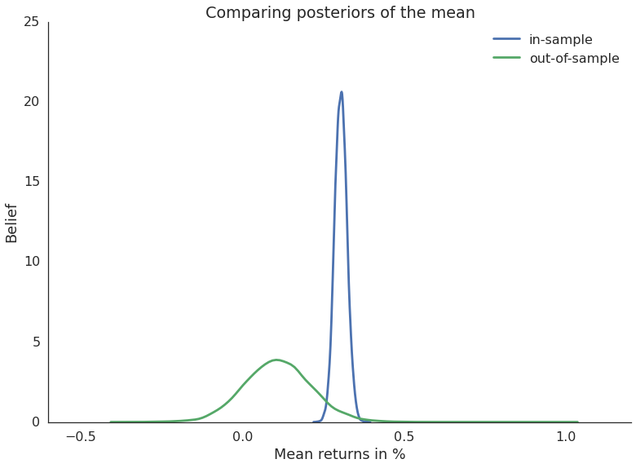
Comparing mean returns
in-sample vs out-of-sample
Notes:
Now to answer our original question, whether the out-of-sample period matches what was suggested by the backtest we can check if the mean of the two distributions is significantly different.
Here we just plot the posterior of the mean returns. It is important to note that this is *not* the returns-distribution itself, but rather our belief in the mean of the returns-distribution. Because we are doing Bayesian statistics, the mean is not a single number but actually a probability distribution that tells us how likely different mean values are. Intuitively, the wider the distribution the more uncertainty we have so you can see that with only a few days of out of-sample data our uncertainty in the mean of that period is much higher than for the backtest period for which we consider a much smaller parameter range as likely.
Given these posteriors we can now ask statistically meaningful questions like what is the probability that the mean returns of the in-sample period is smaller than the out-of-sample period.
3.34% which is very low so in this case we are fairly certain that the backtest is overfit on historical data.

Slide 20
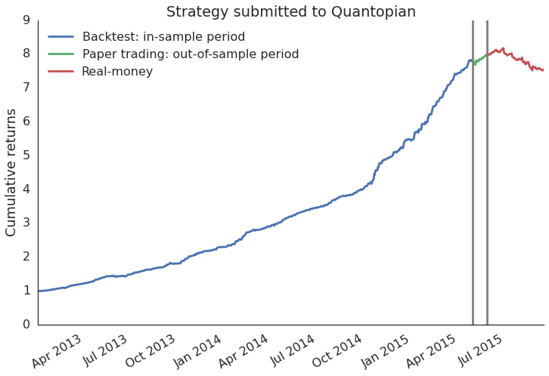
What actually happened
Winner of our trading competition so we deployed real money to that strategy
Notes:
With probabilistic programming we now have a tool to alert us to these problems much sooner so that this won’t happen again.

Slide 21
In practice
Choose the prior distribution
Define the likelihood
Constrain the likelihood to the observed dataset
Obtain the posterior distribution by sampling

Slide 22
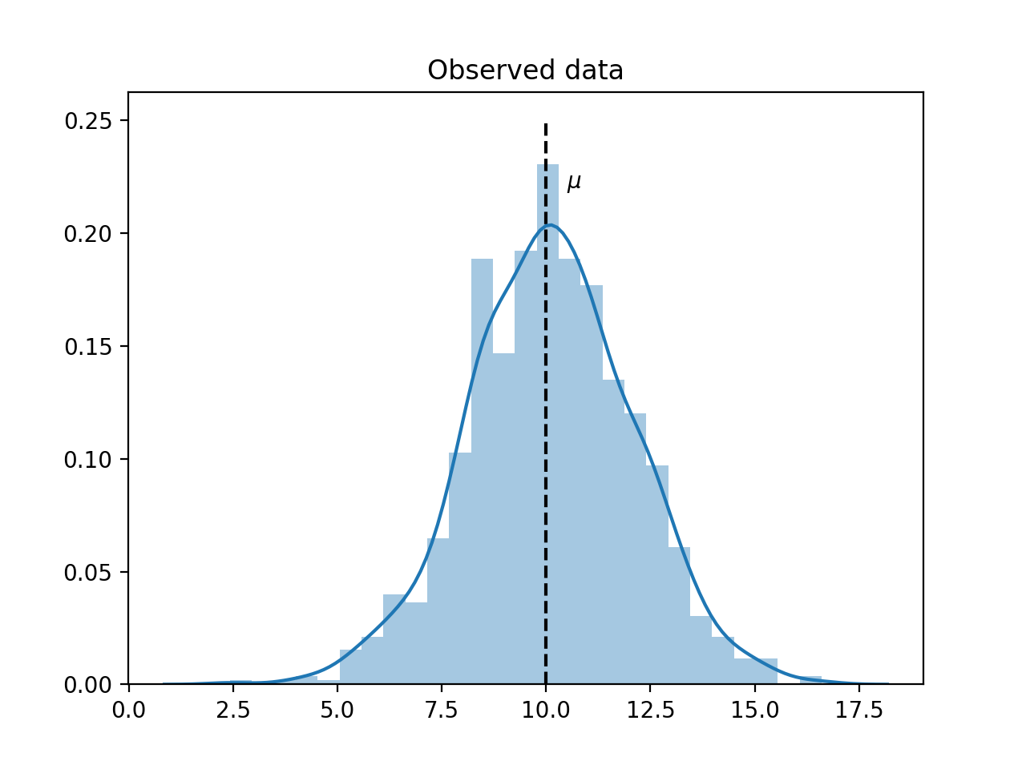
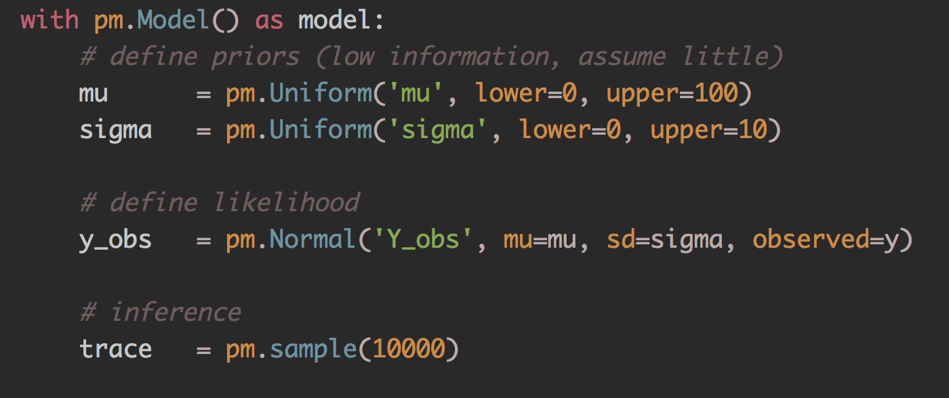
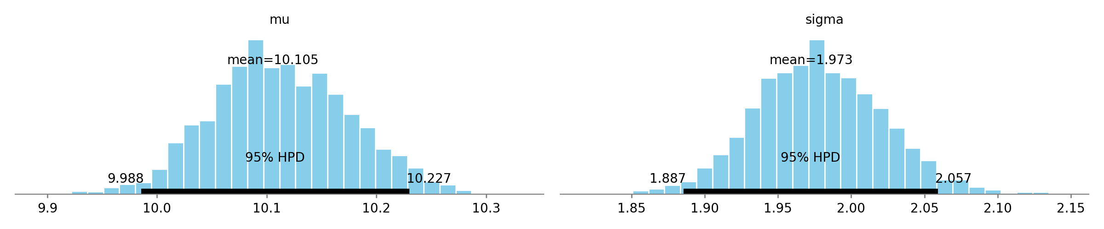
In practice

Slide 23
Bayes formula

Slide 24
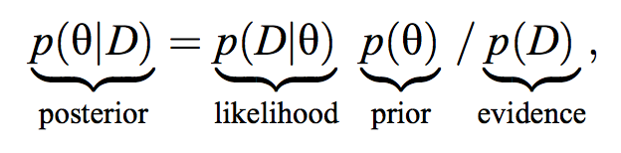
Bayes formula
a posteriori
vraisemblance
a priori
θ: unknown parameter of interest
D: observed data
The posterior distribution provides the most complete information that is mathematically possible about the parameter values given the data.
http://people.duke.edu/~ccc14/sta-663-bootstrap/MCMC.html#bayesian-data-analysis

Slide 25
 |  | Coin Flip
P(θ) is the prior probabilité a priori de θ (probabilité marginale) | This is the strength in our knowledge of θ without considering the evidence D | Our prior view on the probability of how fair the coin is. ~=0.5
P(θ|D) is the posterior distribution a posteriori | This is the (refined) strength of our knowledge of θ once the evidence D has been taken into account. | After seeing 4 heads out of 8 flips, say, this is our updated view on the fairness of the coin.
P(D|θ) is the likelihood fonction de vraisemblance | This is the probability of seeing the data D as generated by a model with parameter θ. | If we knew the coin was fair, this tells us the probability of seeing a number of heads in a particular number of flips.
P(D) is the evidence | This is the probability of the data as determined by summing (or integrating) across all possible values of θ, weighted by how strongly we believe in those particular values of θ | If we had multiple views of what the fairness of the coin is (but didn't know for sure), then this tells us the probability of seeing a certain sequence of flips for all possibilities of our belief in the coin's fairness.

Slide 26
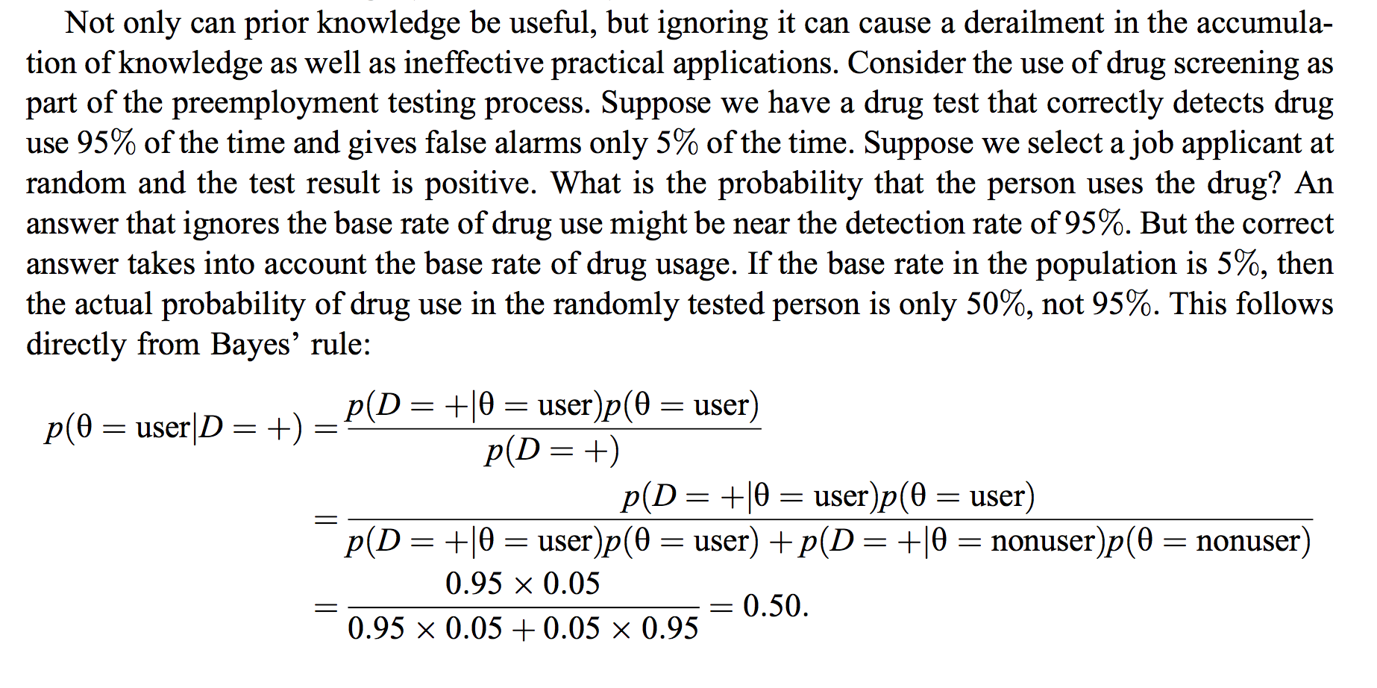
Exercice

Slide 27
Imaginons un test extrêmement fiable :
si un patient a contracté la maladie, le test est positif, presque systématiquement, 99 % des fois, soit avec une probabilité 0.99 ;
si un patient est sain, le test est correct, c’est-à-dire négatif dans 95 % des cas, soit avec une probabilité 0.95.
Imaginons que la maladie ne touche qu’une personne sur mille, soit avec une probabilité 0,001.
Quelle est la probabilité qu’un test soit positif à tort (surdiagnostic) ?

Slide 28
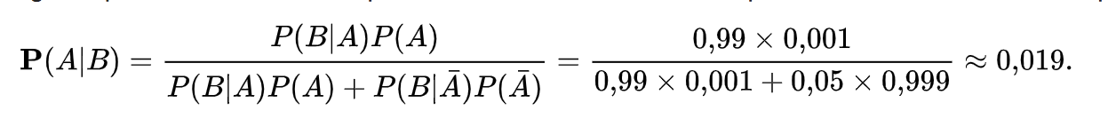
Désignons par
A l’événement « Le patient a contracté la maladie »
B l’événement « Le test est positif ».
Le théorème de Bayes dans le cas discret donne alors :
Traduit en langage courant, cette équation signifie que « la probabilité que le patient ait réellement contracté la maladie, quand le test est positif, n'est que de 1,9 % ».
Sachant que le test est positif, la probabilité que le patient soit sain vaut donc environ : (1 − 0,019) = 0,981.
Du fait du très petit nombre de malades, en effet,
pratiquement tous les malades présentent un test positif, mais aussi
pratiquement tous les tests positifs désignent des personnes saines.

Slide 29
Conjugate prior

Slide 30
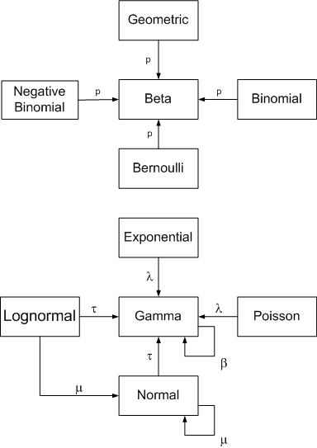
Conjugate prior
If the posterior distribution is in the same probability distribution family as the prior probability distribution, the prior and posterior are called conjugate distributions, and the prior is called a conjugate prior for the likelihood function
https://www.johndcook.com/blog/conjugate_prior_diagram/

Slide 31
Conjugate prior
Closed form likelihood when prior is Gaussian, Beta, Poisson, binomial, multinomial
Or:
Likelihood is not a distribution
Linear regression with basis function
Logistic regression
Any other formula
Otherwise need to estimate the likelihood integral over all dimensions
=> Monte Carlo
=> Monte Carlo Markov Chain
Cours Statistique Bayésienne Dhafer Malouche ESSAI.pdf
https://rstudio-pubs-static.s3.amazonaws.com/123385_7a2370d74be24f3caeaca9bc991a3026.html

Slide 33
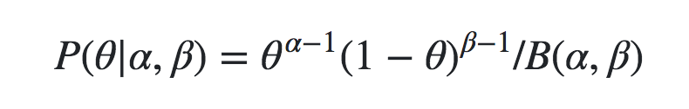
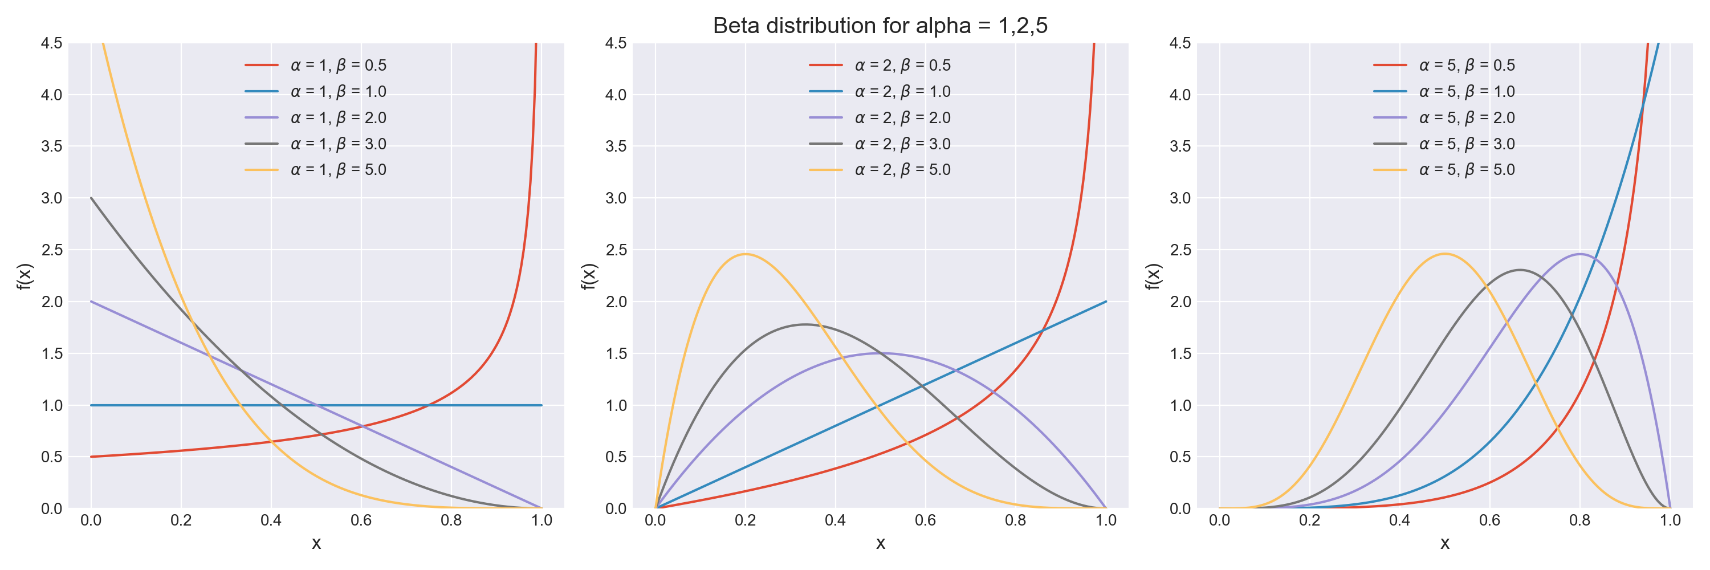
Beta distribution

Slide 34
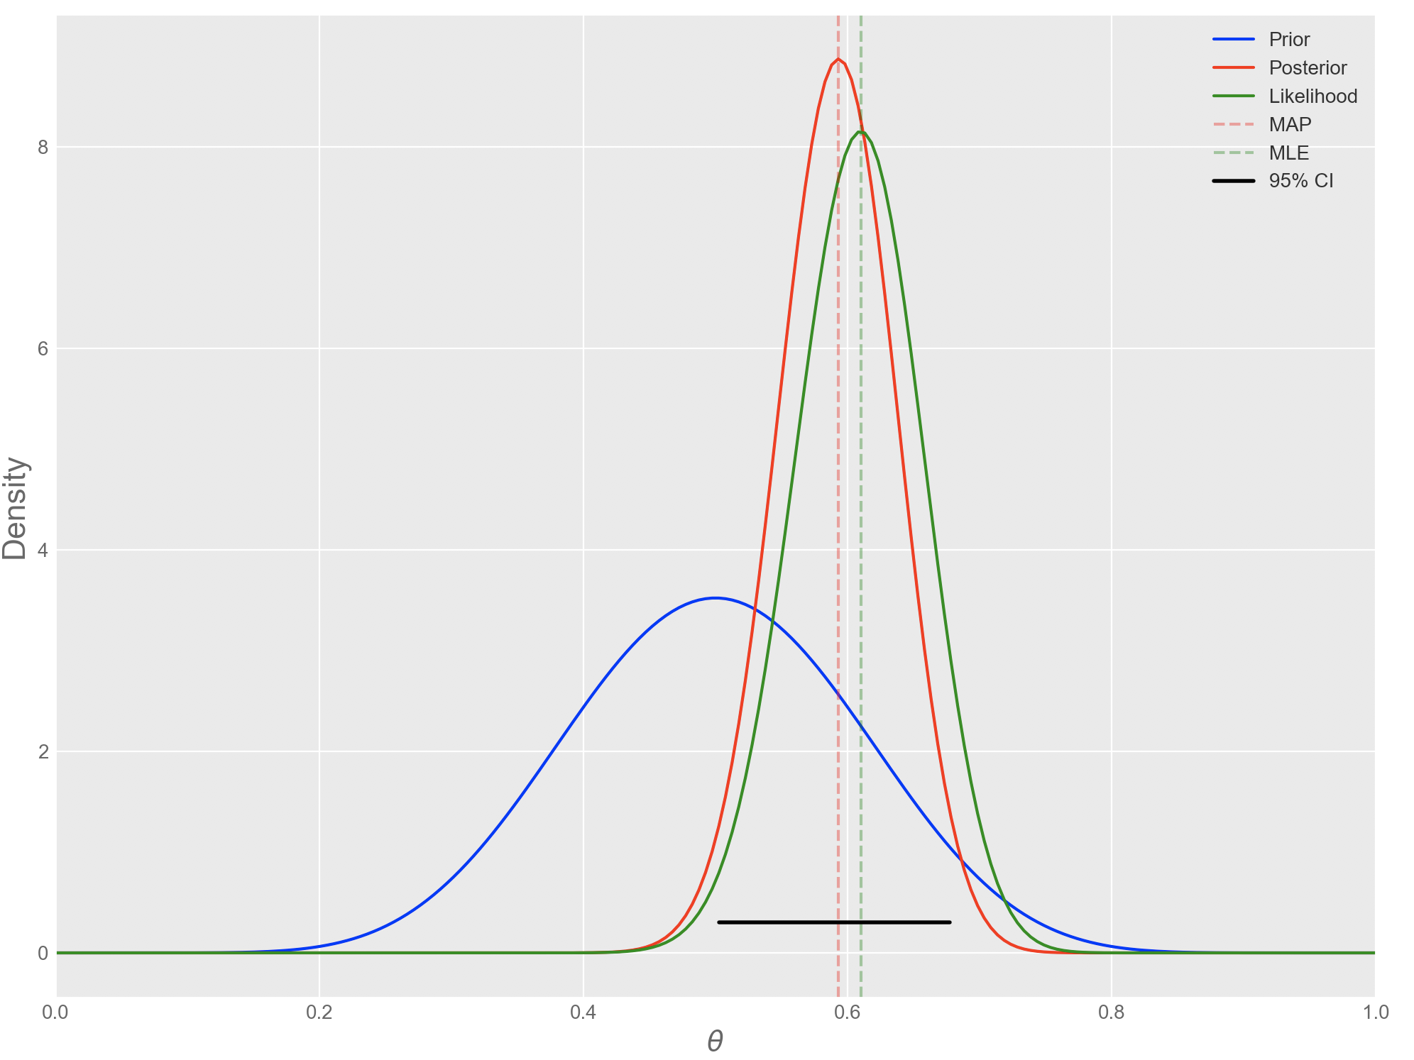
Beta-Binomial
the probability p of a coin landing on head is modeled to be Beta distributed (with parameters α and β), while the likelihood of heads and tails is assumed to follow a Binomial distribution with parameters n (number of flips) and the Beta-distributed p, thus creating the link:
Prior ∼ Beta(α,β)
Likelihood ∼ Binomial(n,p)
Posterior ∼ Beta( α+ p,n - p +β)
https://www.quantstart.com/articles/Bayesian-Inference-of-a-Binomial-Proportion-The-Analytical-Approach

Slide 35
Recap

Slide 36
ML is brute force, black box, requires volumes of data
Stats
too dependent on the interpretation of the Null hypothesis / p-value
Valid at infinity
Probabilistic programming is a 3rd way:
Build a fully understood model of the data in a Bayesian context
P(theta / D) = P(D / theta) P(theta) / P(D)
Use sampling (MCMC, HMC, …) to infer the posterior distribution P(theta / D)
PyMC3, Pyro, Stan, Tensorflow probabilities, …

Slide 37
Lab 01

Slide 38
Install
conda install -c conda-forge pymc3
conda install -c conda-forge theano

Slide 39
Gaussian

Slide 40
Exercice
Generate N(mu, sigma)
Estimate mu and sigma
prior mu, sigma : uniform
likelihood: N(mu, sigma, observed = data)
sample

Slide 41
Coin Flip

Slide 42
Inference on a binomial proportion
Engineering: Estimating the proportion of aircraft turbine blades that possess a structural defect after fabrication
Social Science: Estimating the proportion of individuals who would respond "yes" on a census question
Medical Science: Estimating the proportion of patients who make a full recovery after taking an experimental drug to cure a disease
Corporate Finance: Estimating the proportion of transactions in error when carrying out financial audits
Data Science: Estimating the proportion of individuals who click on an ad when visiting a website

Slide 43
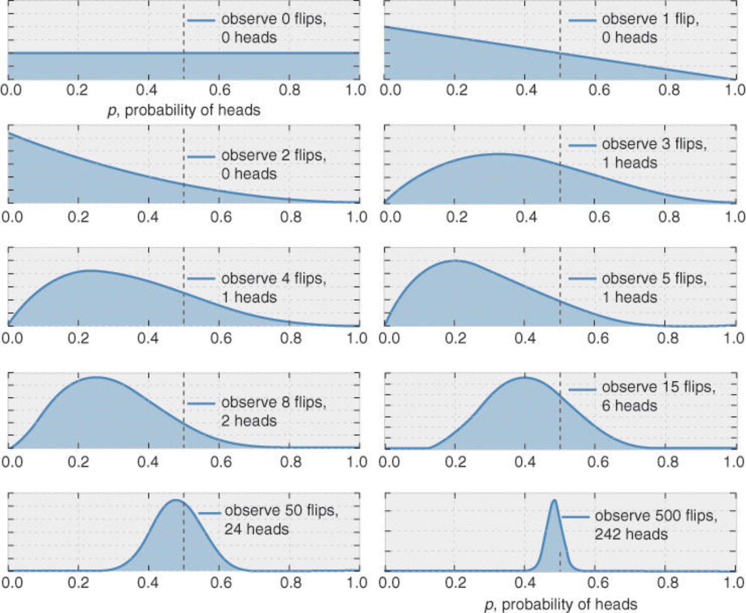
Coin flip
Estimer Bernoulli(p) en fonction d'une serie de coin flip
plus on a de data, meilleure est l'estimation
MLE: |H| / |Flips|

Slide 44
PP in action: coin flip
From data of N trials (flips), can we infer p(X = head) ?
data = st.bernoulli.rvs(p, n = #trials)
Model the prior
p = pm.Uniform('p', lower = 0, upper = 1)
Model the observed data (likelihood)
y = pm.Binomial('y', n = #trials, p = p, observed = data)
Sample the posterior distribution
trace = pm.sample(<Number of samples>, step = <Sampler>, …. )

Slide 45
Dice rolls

Slide 46
Dice rolls
the Multinomial (i.e. multiple choices) distribution is a generalization of the Binomial distribution (i.e. binary choice)
the Dirichlet distribution is a generalization of the Beta distribution.
That is, while the Beta distribution models the probability of a single probability p, the Dirichlet models the probabilities of multiple, mutually exclusive choices, parameterized by a which is referred to as the concentration parameter and represents the weights for each choice
dice : a = 1/6, 1/6 …. 1/6
coins for the Beta-Binomial distribution
dice for the Dirichlet-Multinomial distribution.
θ∼Dirichlet(a)
y∼Multinomial(n,θ)

Slide 47
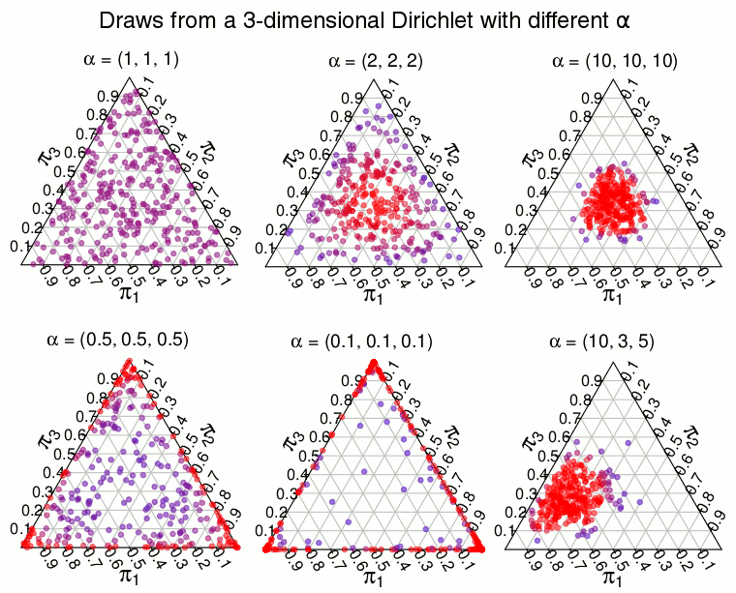
Dirichlet
2-dimensional Dirichlet is the same as a Beta distribution and is defined on the line where π1+π2 is always 1,
3-dimensional Dirichlet is defined on the triangle where π1+π2+π3 = 1
A K-dimensional Dirichlet has K parameters α=(α1,…,αK) where the expected proportion of, say, π1 is α1/∑α1..K .
The higher the sum of all the ααs, the more the distribution concentrates on the expected proportion. If instead ∑α1..K approaches 0, the distribution concentrates on points with few large proportions.

Slide 48
Polling

Slide 49
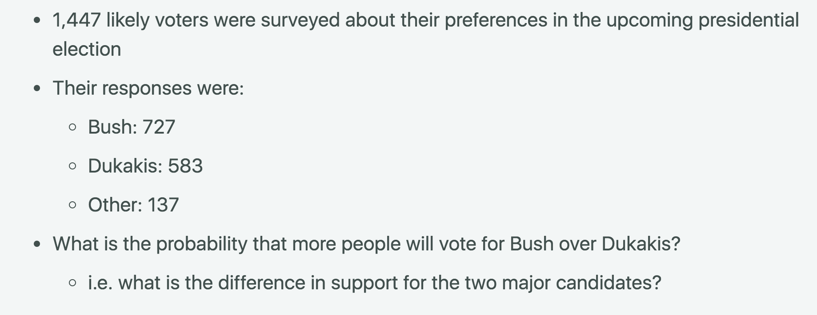
Dice, Polls & Dirichlet Multinomials
Article : https://calogica.com/python/pymc3/2018/11/27/dice-polls-dirichlet-multinomial.html
Notebook : https://nbviewer.jupyter.org/github/clausherther/public/blob/master/Dirichlet%20Multinomial%20Example.ipynb#Polling-#1

